Slide 1
Welcome to our presentaion

Slide 2
Group Member:
Imam Hossain Sajeeb- 2018-1-60-173
Didarul Islam- 2016-2-60-080

Slide 3
Resolving Flight Overbooked
Overview
Introduction
The Purpose of the Project
Description
Future Work
Conclusion

Slide 4
Introduction:
Helpful for airline.
Maintaining priority.
we can inform them earlier.
Airline has following system:
Input passenger details.
Data of booked passenger.
Give them a priority base on their details.
Collect data for long time use.
Give output of waiting list for all passenger.

Slide 5
The Purpose of the Project:
When a flight is overbooked, the airline must figure out then which passengers aren't going to make it on board.
we are going to give them the position of the flight

Slide 6
Description:
we are taking many parameters from the customer like how many mileages he travelled from this travel agency, how many years he is been a member of this agency, and his position of the queue.
Function details:
calc_prior(): It will take the parameter of the last sequence number and calculate the
priority using this equation " priority=(mileage/1000) +years-sequence; ".
heap_up(): It will take the parameter of the sequence number minus one and divide the
parameter by two and check the priority number of the two index. If last value is
greater than the middle then swap the values. And do this operation recursively until the parameter is less than one.
heap_down(): This operation executes for the whole vector list.
final_list(): It will take the size of the vector list then show list with the priority.

Slide 7
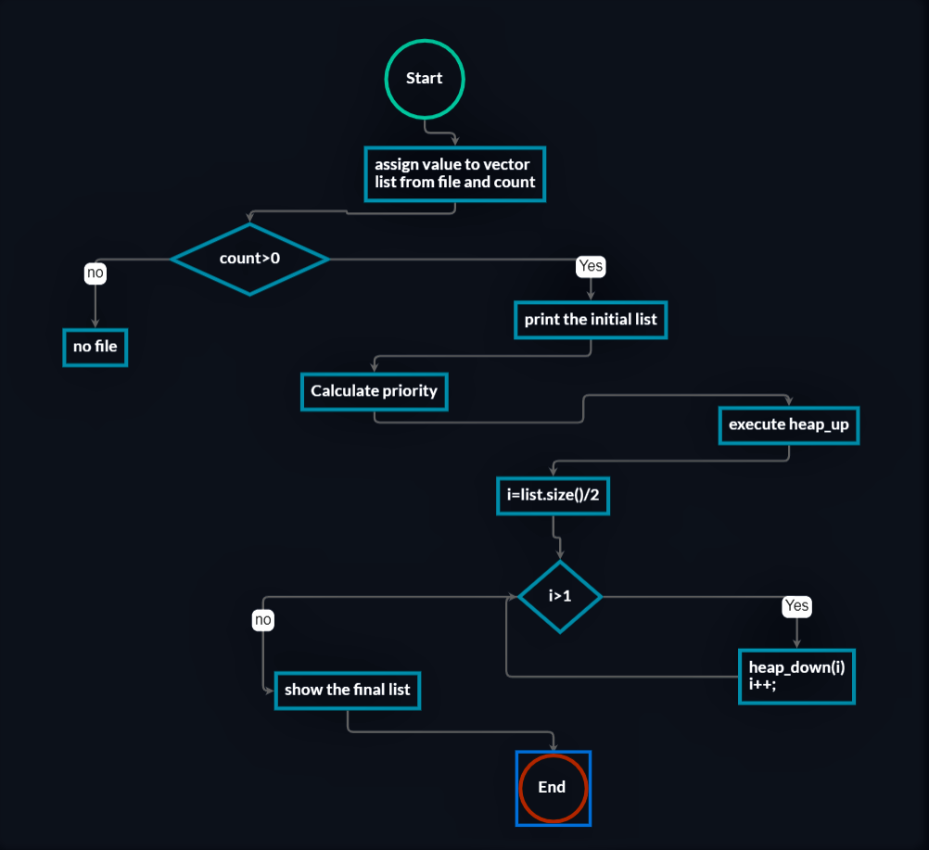

Slide 8
Future work:
Need to recalculate the whole data for the priority list.
Avoiding the recalculation and it will able to take one record.

Slide 9
Conclusion:
Priority list which can satisfy each and everyone.
This list will help the customer to make proper decision and hope it would make their travel easy.

